Slide 1
Accuracy, Sensitivity & Specificity

Slide 2
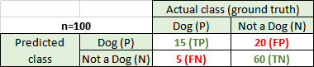
Accuracy
Accuracy = (TP+TN)/(TP+FP+FN+TN)
= (TP+TN)/total
= (15+60)/100
= 0.75

Slide 3
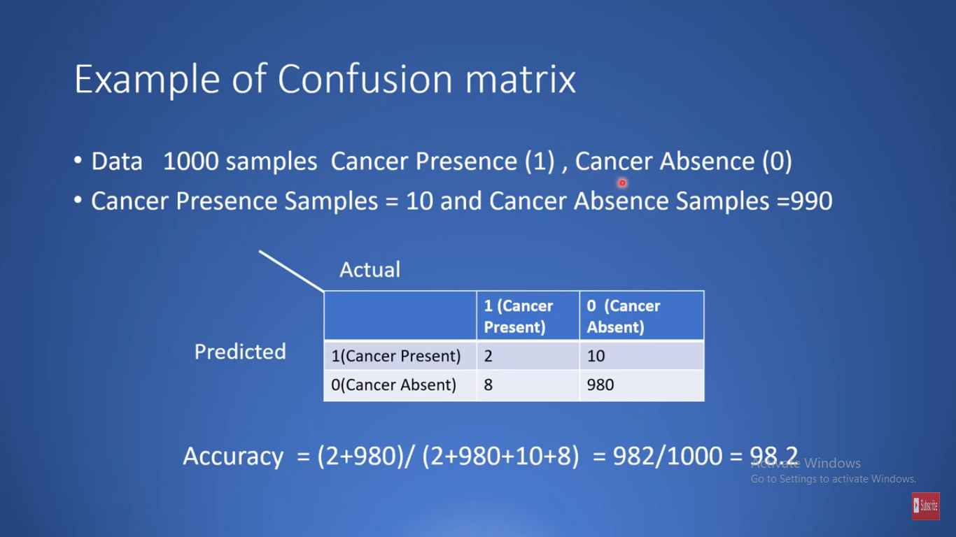
Accuracy…………..good/bad..?

Slide 4
Precision
What’s the proportion of positive class identifications is correct? In other words, if the classifier predicted a positive class, how often is it correct?
Precision for Dog = TP/Predicted positive
= TP/(TP+FP)
= 15/35 = 0.42
Out of all the times Dog was predicted, 42% of the time, the classifier was correct.

Slide 5
Recall/Sensitivity
What’s the proportion of the actual positive class is identified correctly? In other words, when it’s actually positive, how often does it predict positive?
Recall for Dog = TP/Actual positive
= TP/(TP+FN)
= 15/20 = 0.75
Out of all the times Dog labels should have been predicted, the classifier correctly predicted 75% of the labels.

Slide 6
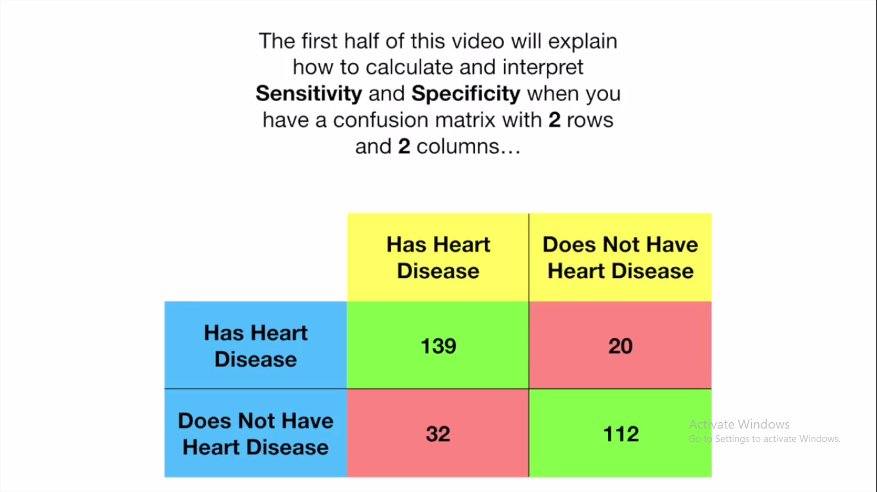

Slide 7
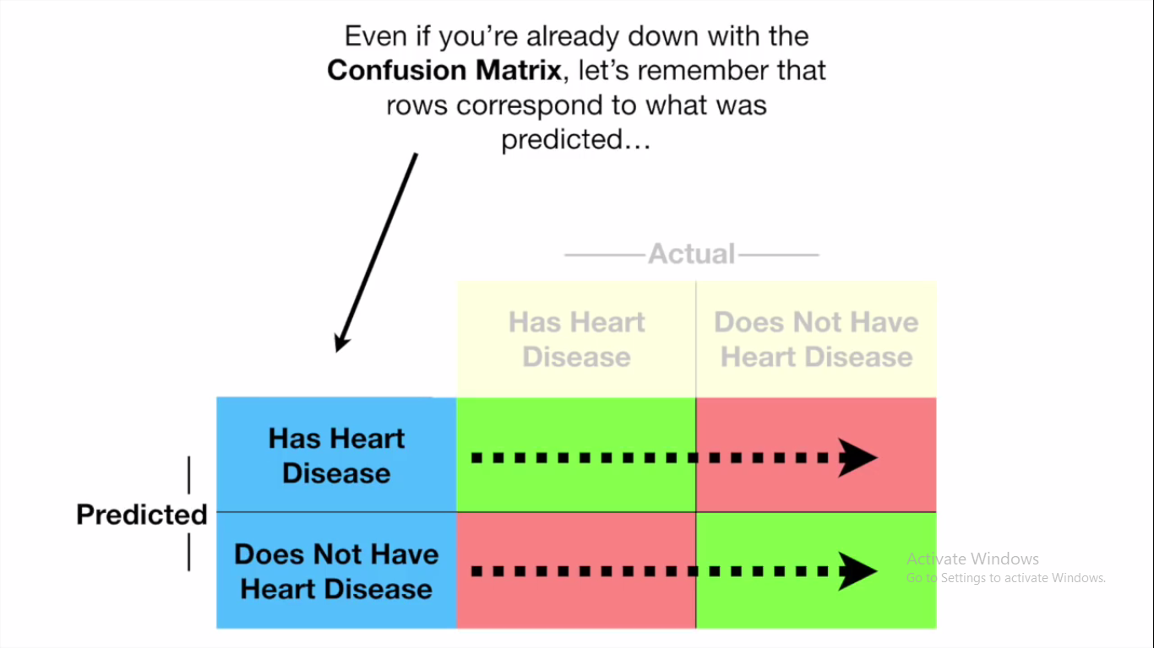

Slide 8
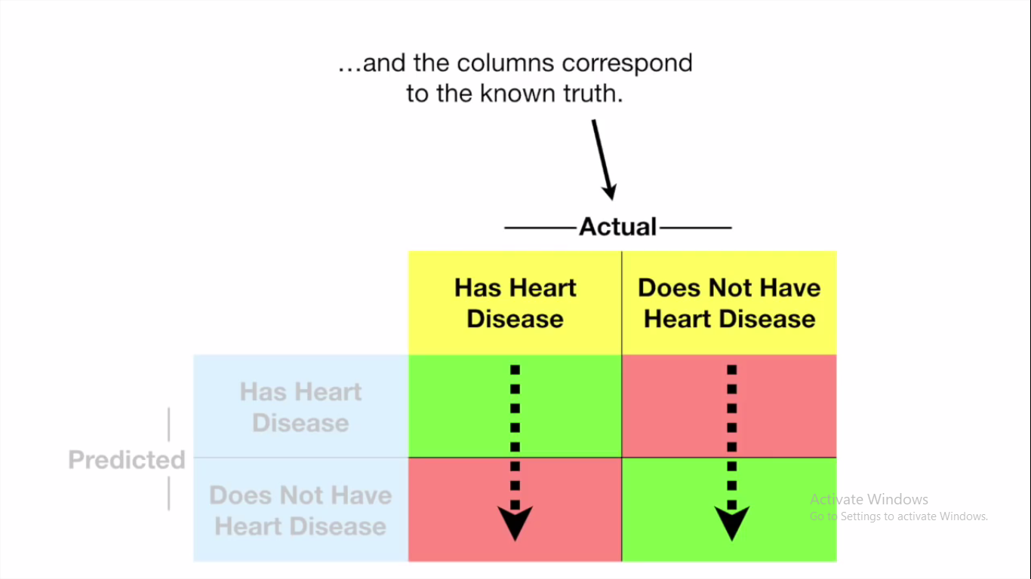

Slide 9
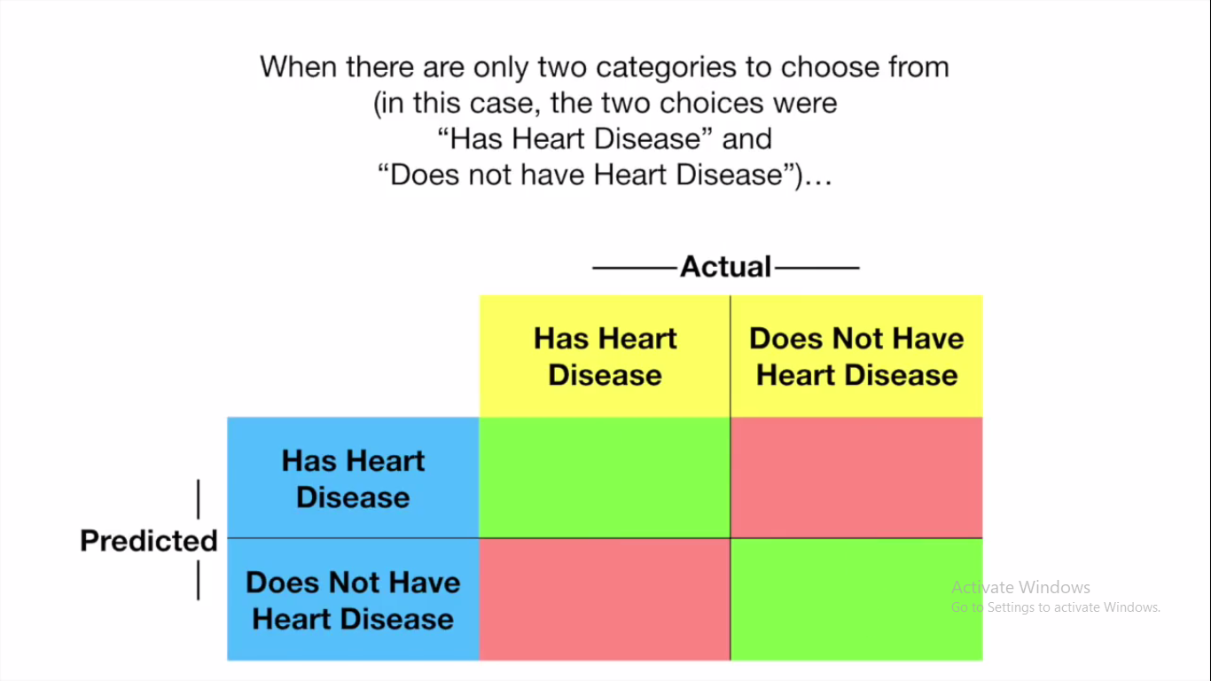

Slide 10
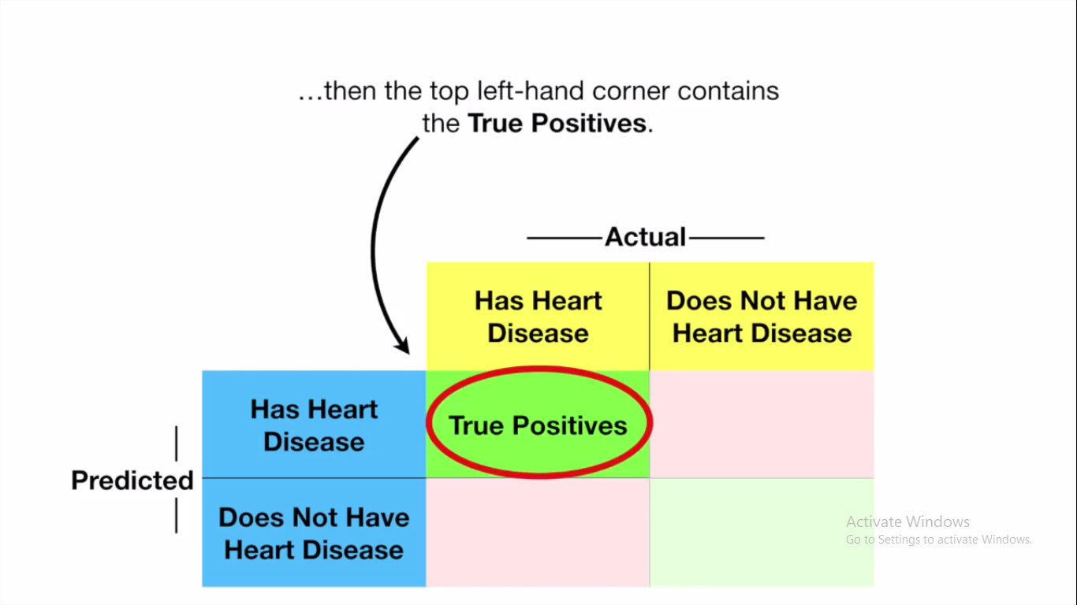

Slide 11
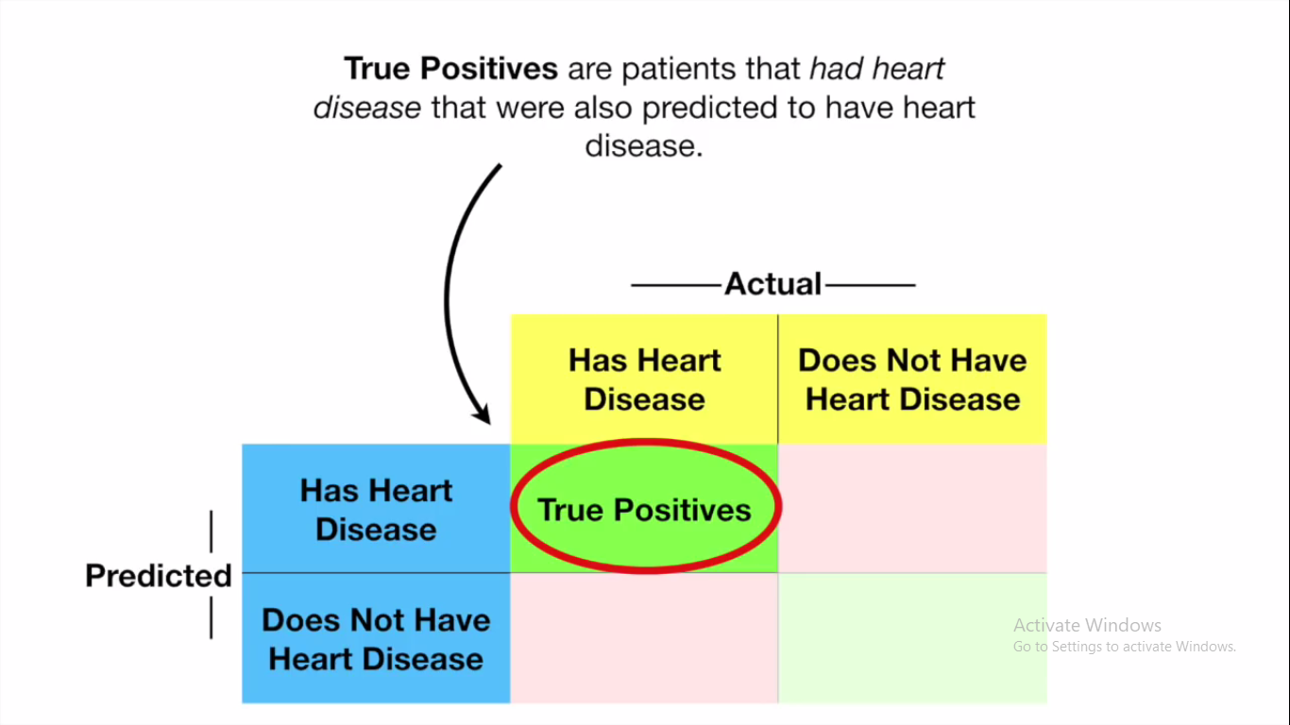

Slide 12
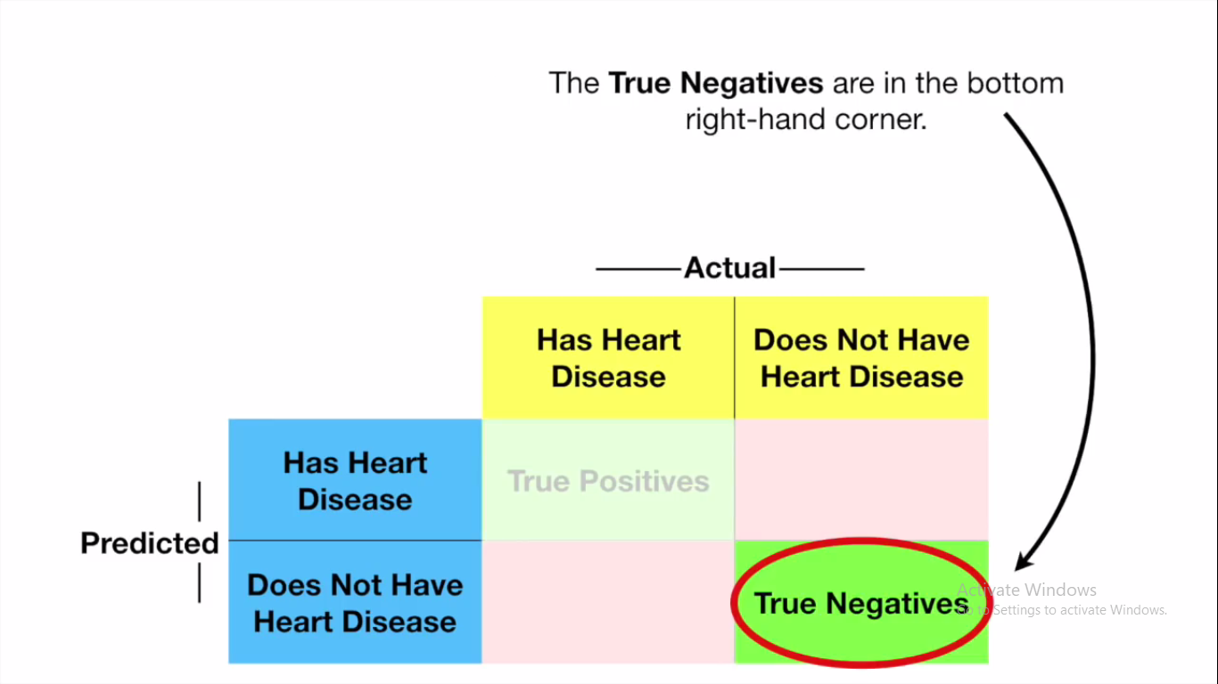

Slide 13
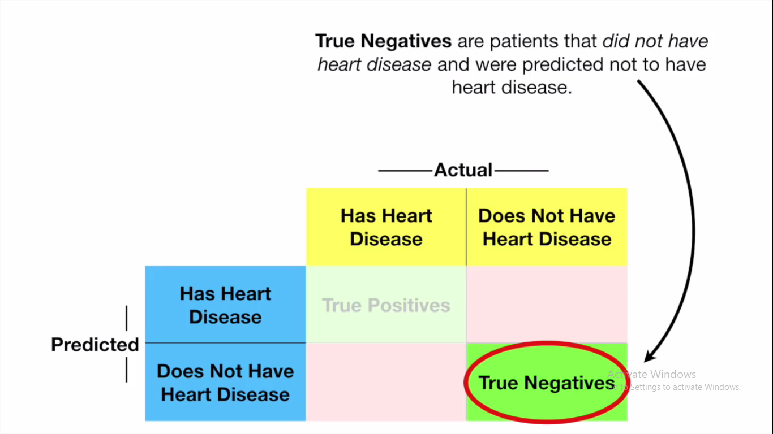

Slide 14
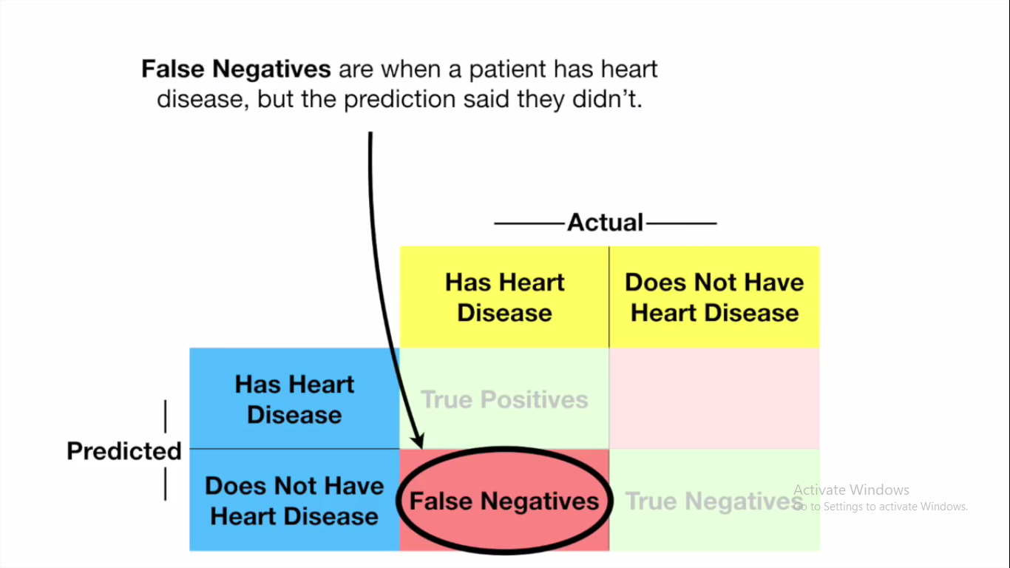

Slide 15
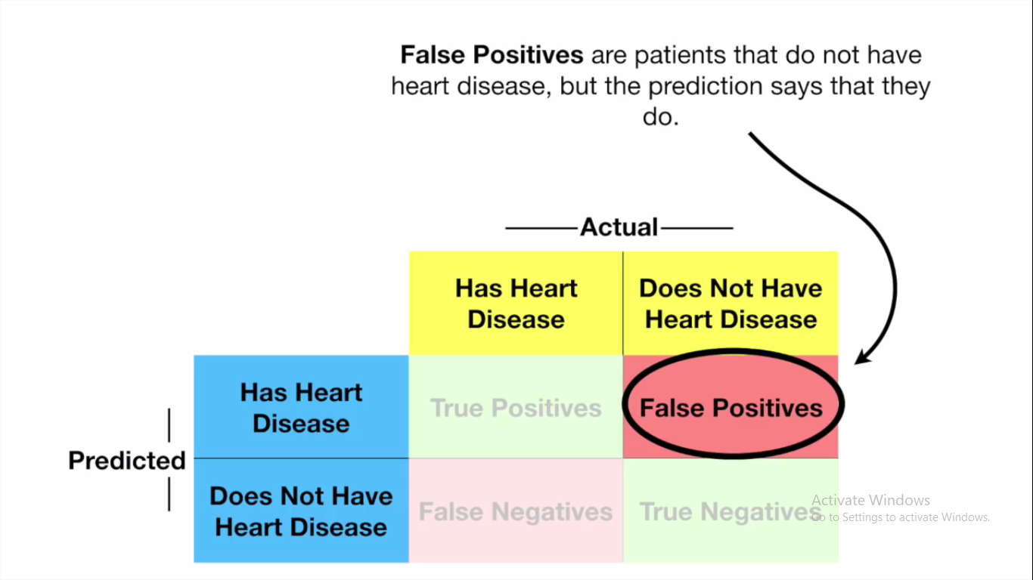

Slide 16
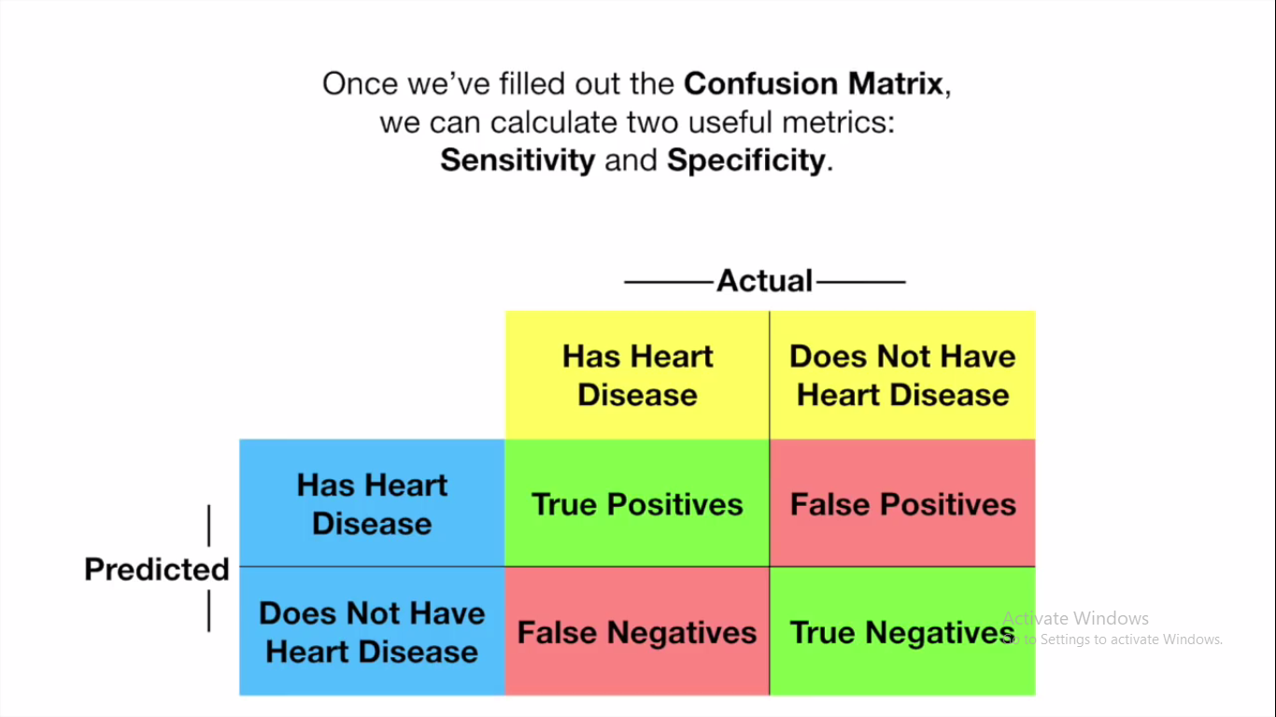

Slide 17
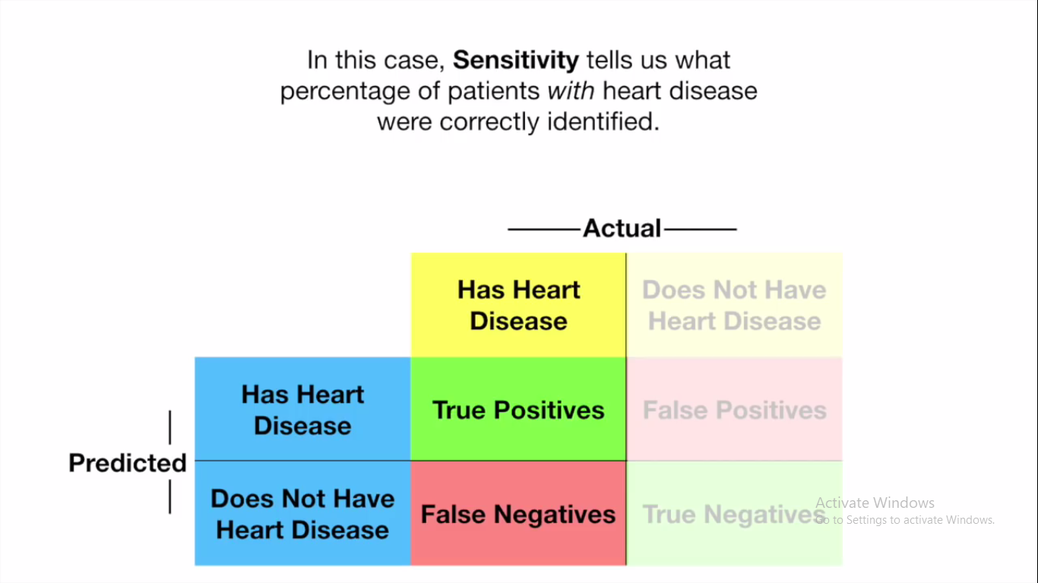

Slide 18
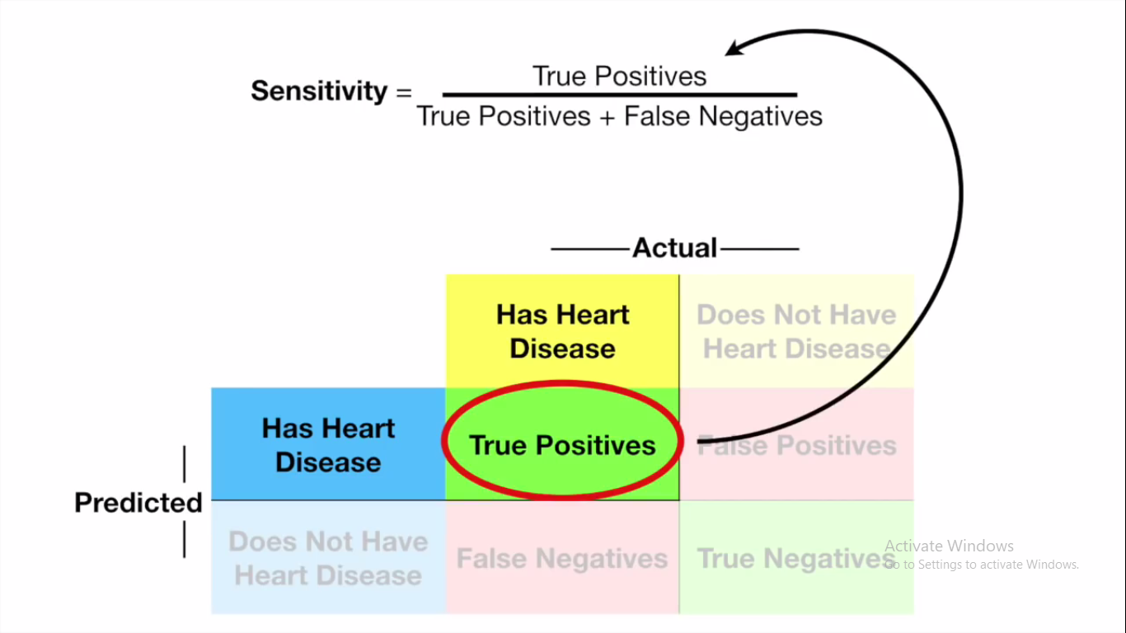

Slide 19
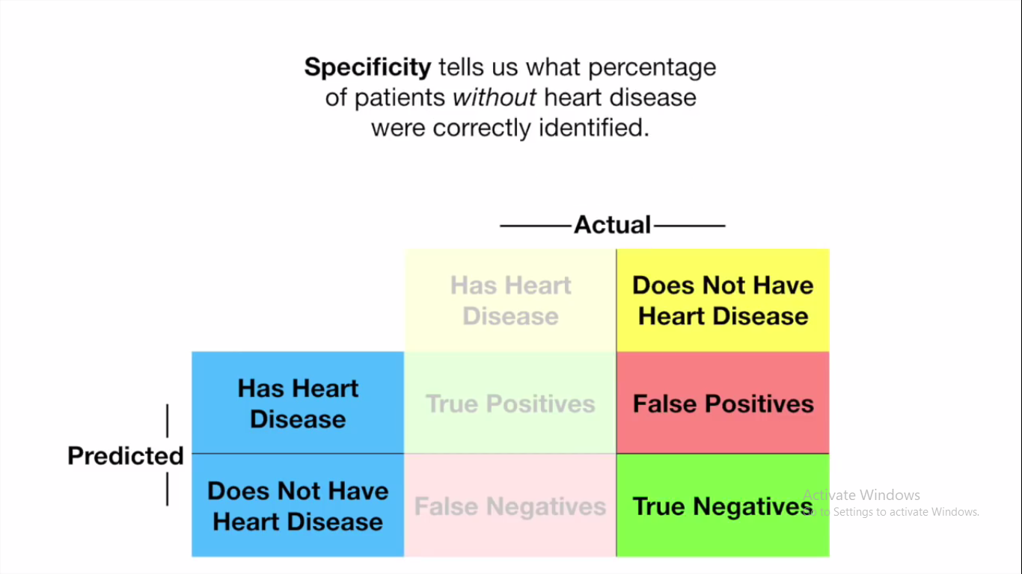

Slide 20
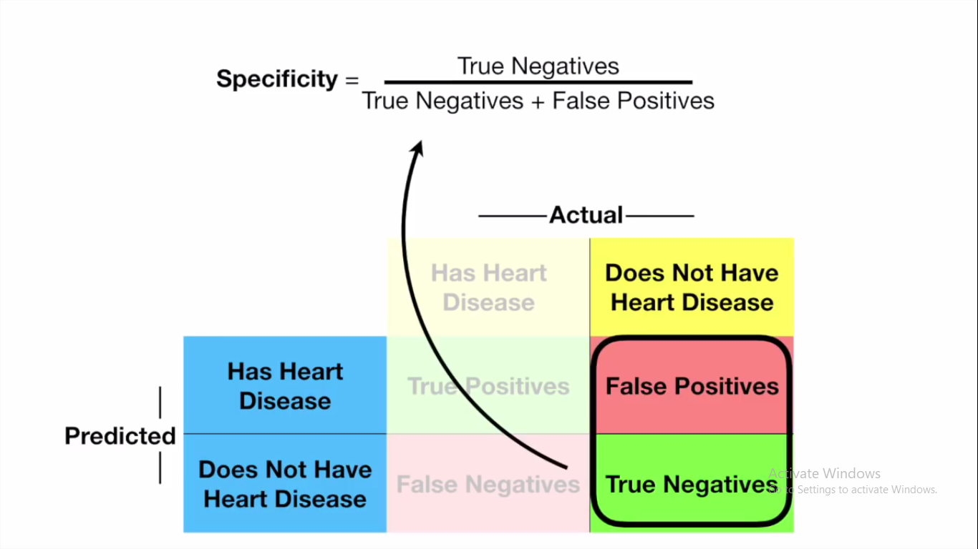

Slide 21
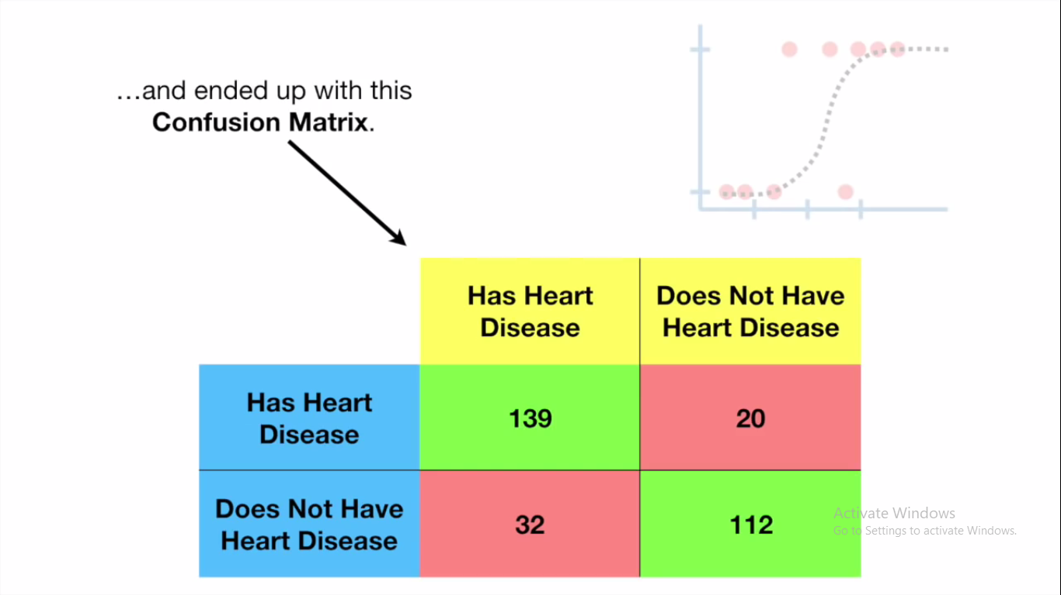

Slide 22
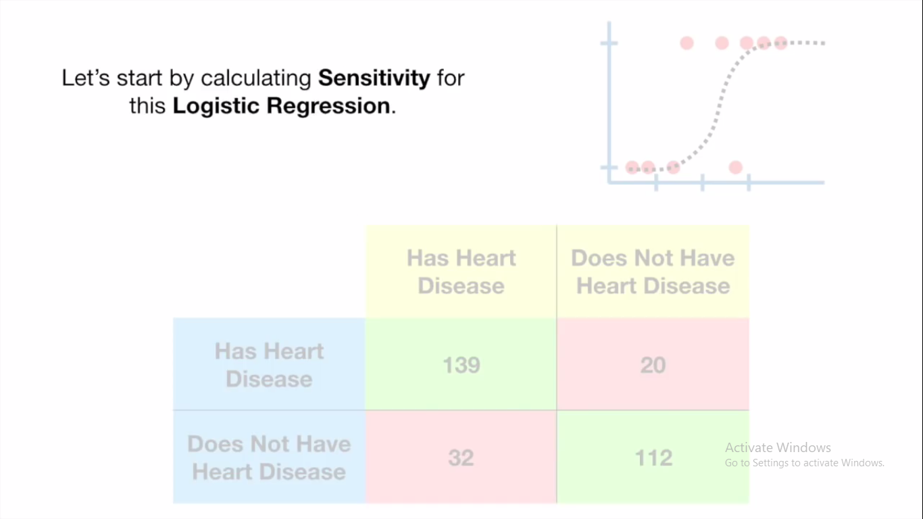

Slide 23
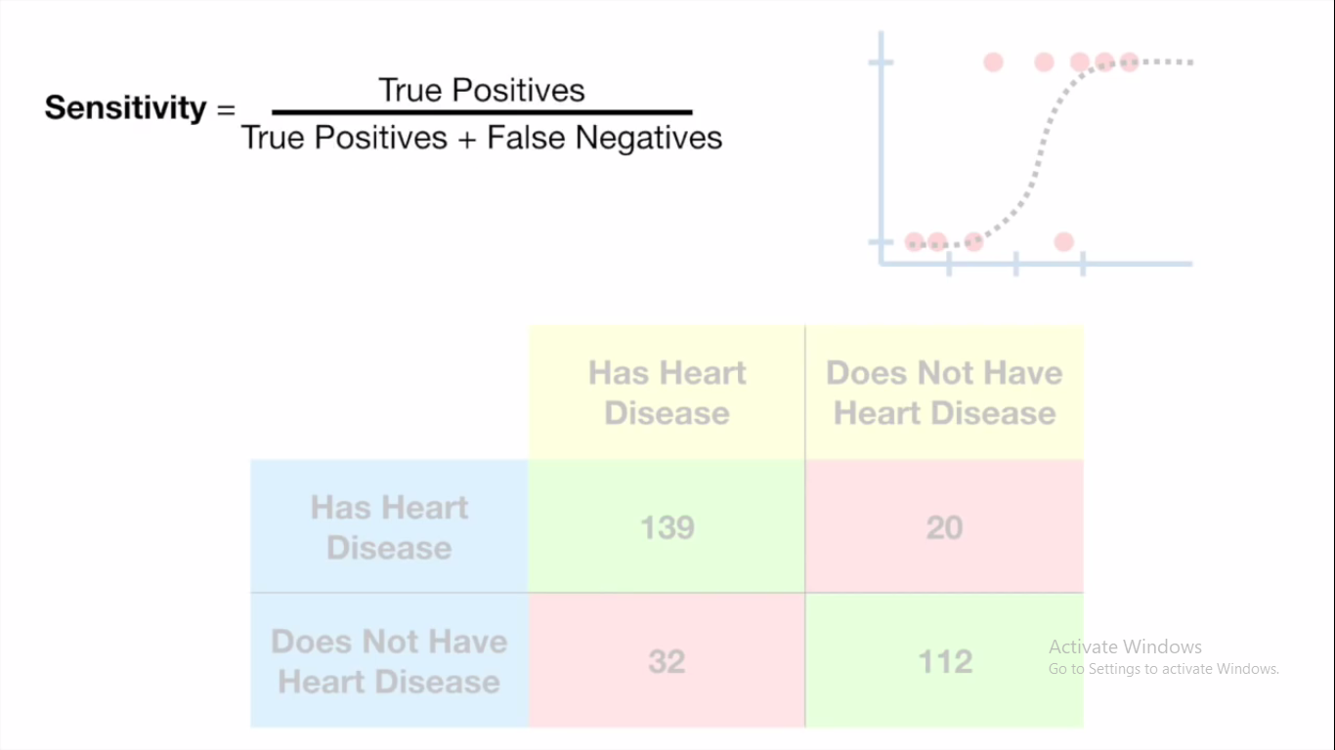

Slide 24
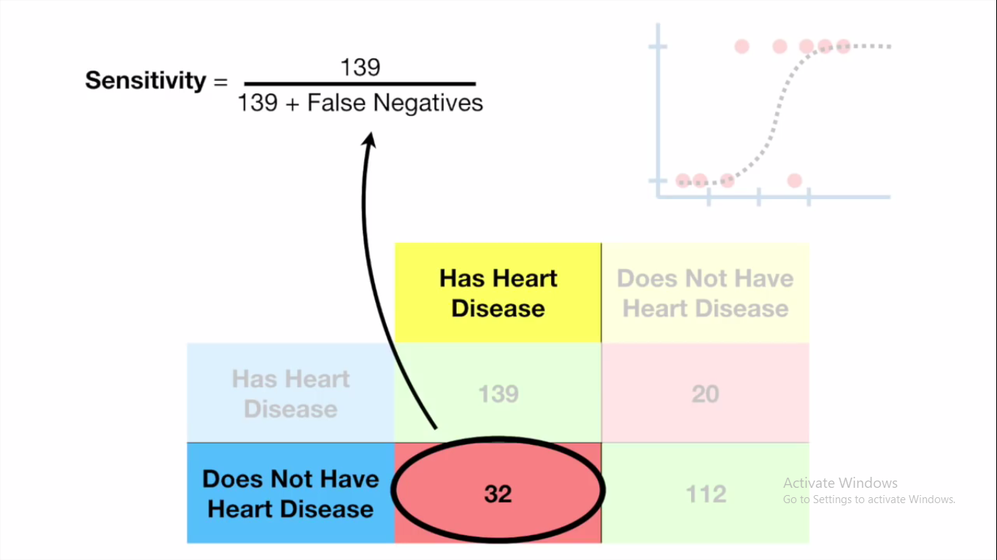

Slide 25
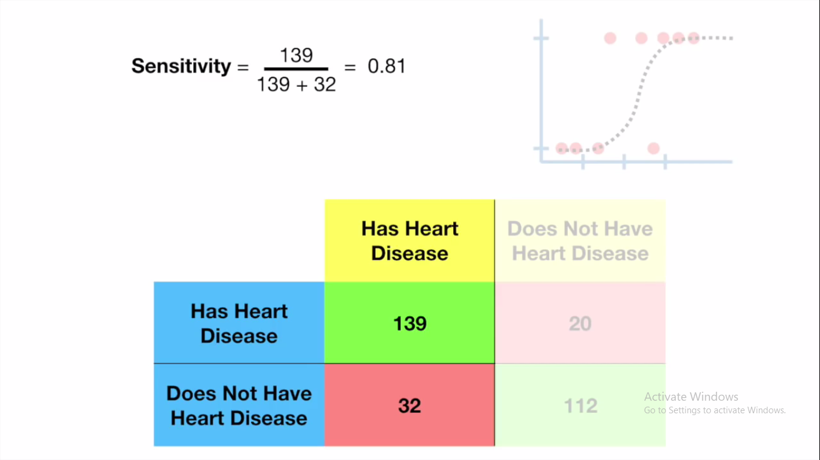

Slide 26
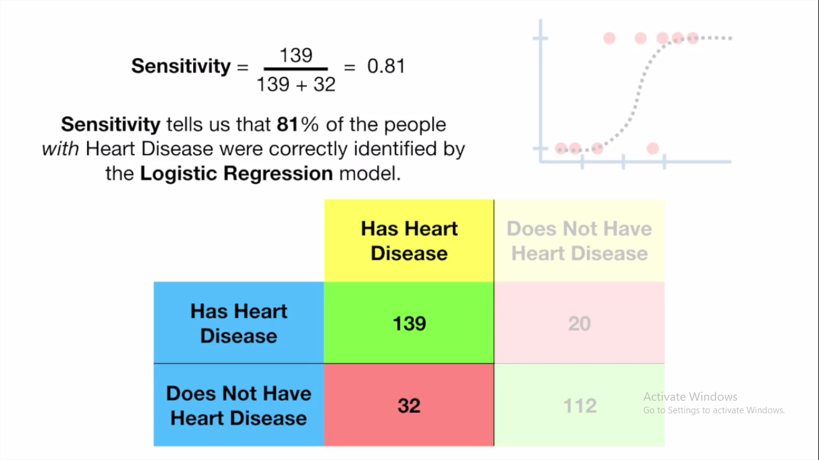

Slide 27


Slide 28
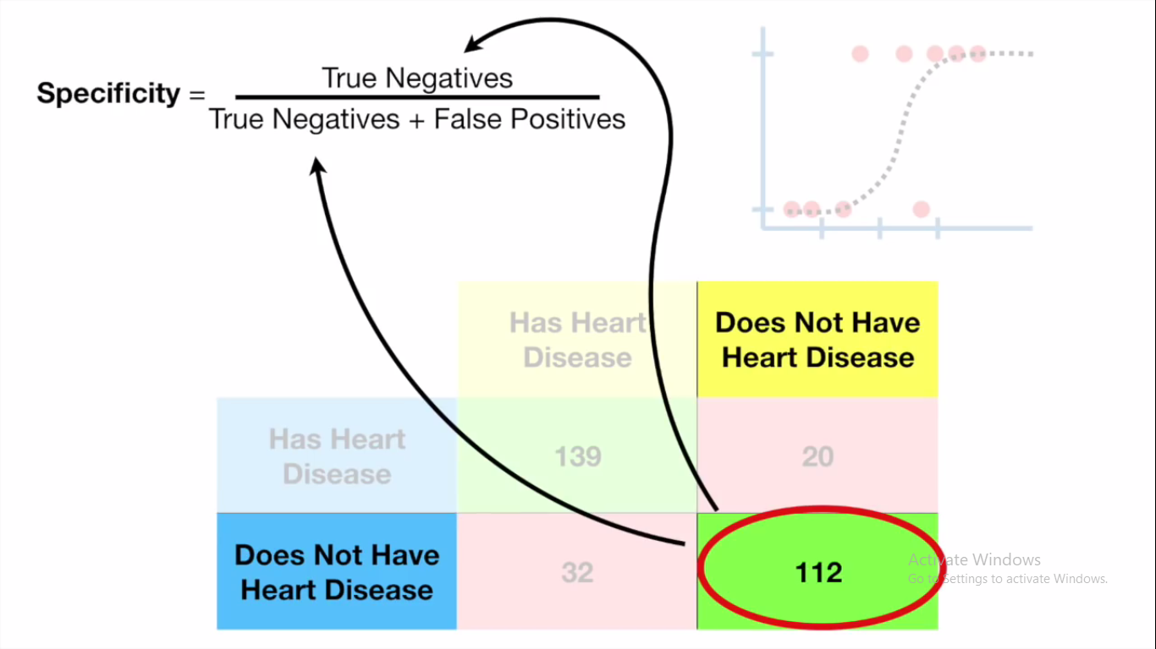

Slide 29
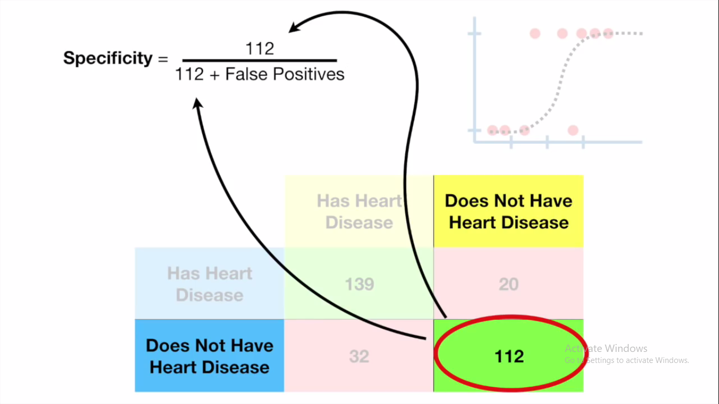

Slide 30
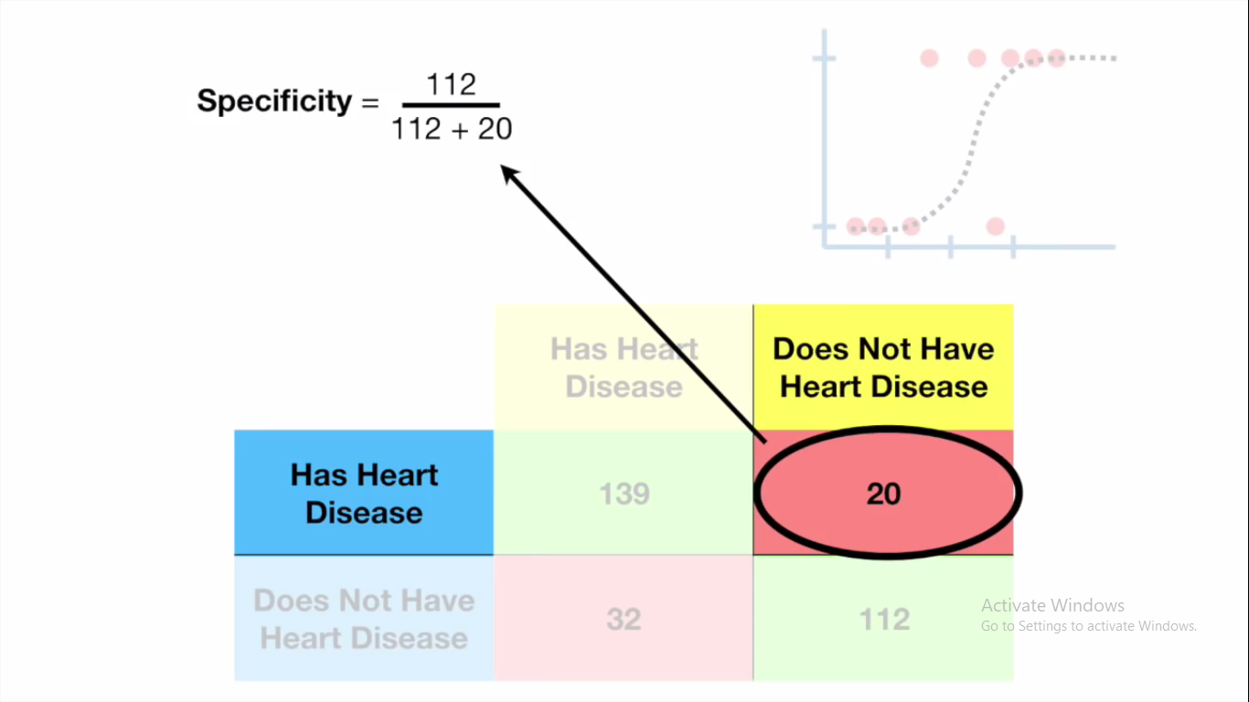

Slide 31
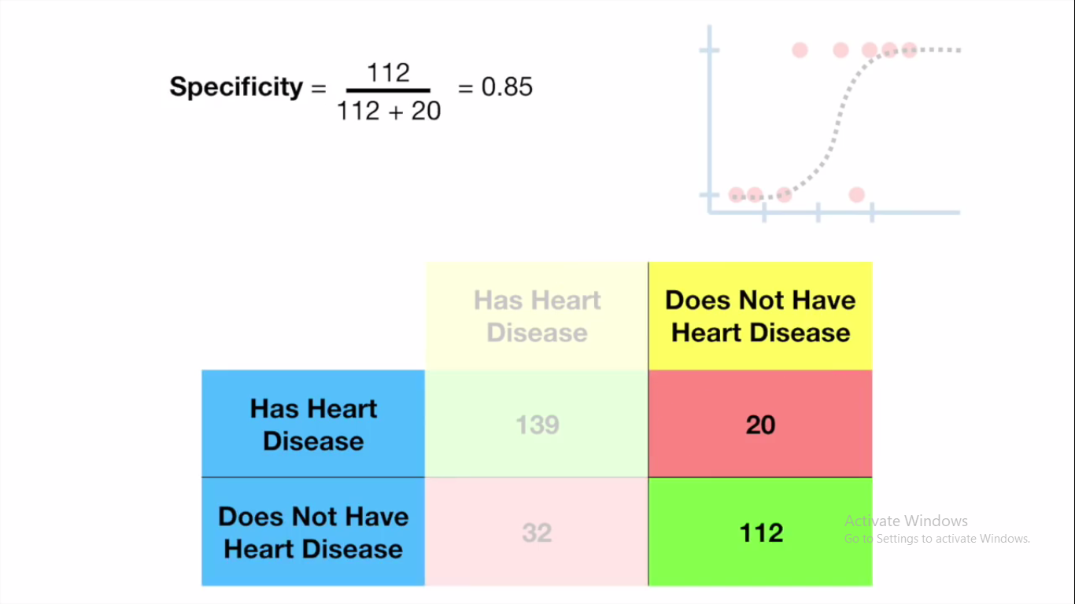

Slide 32
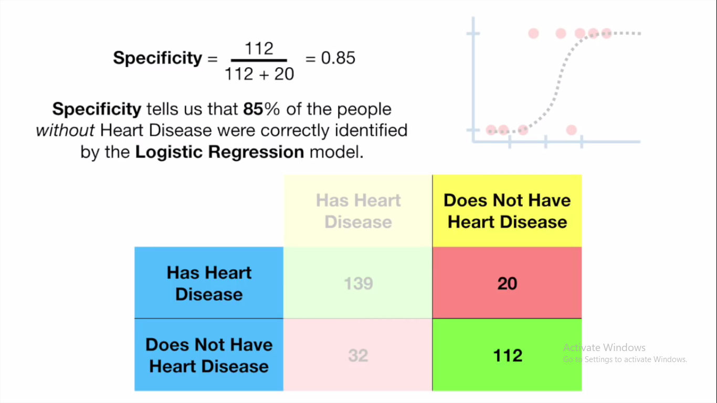

Slide 33
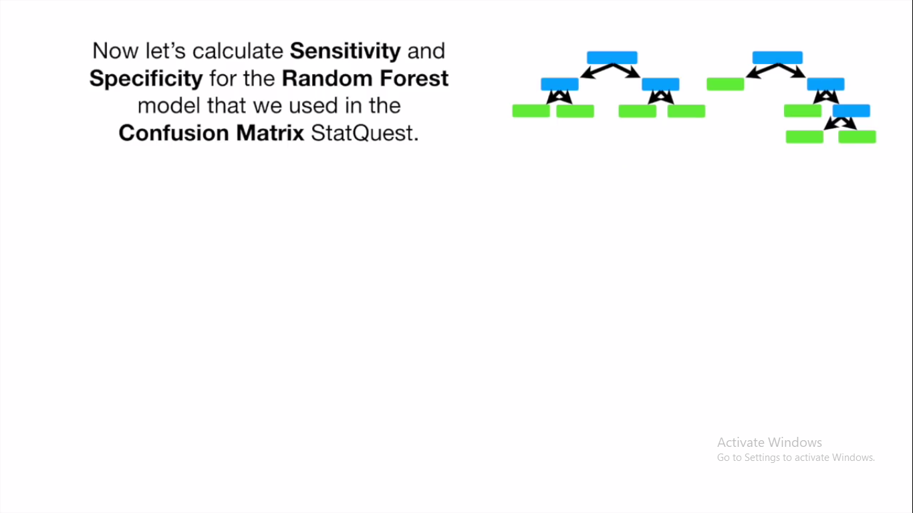

Slide 34
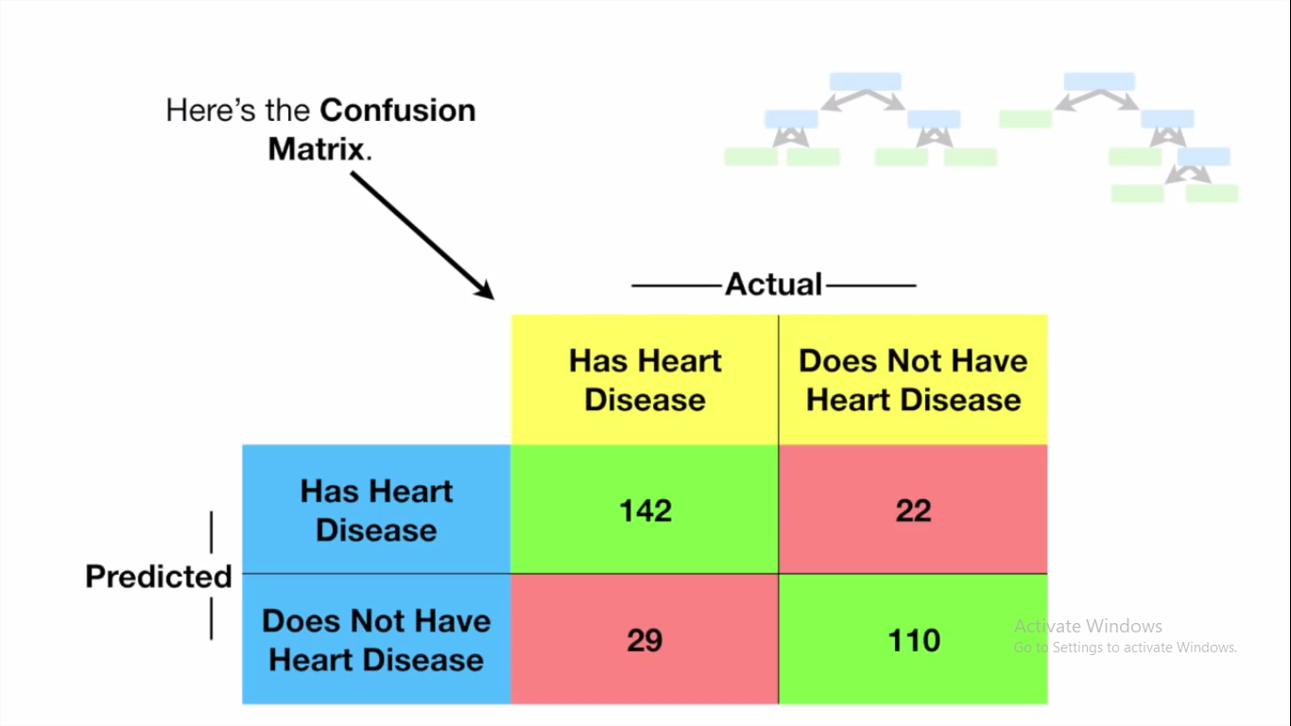

Slide 35
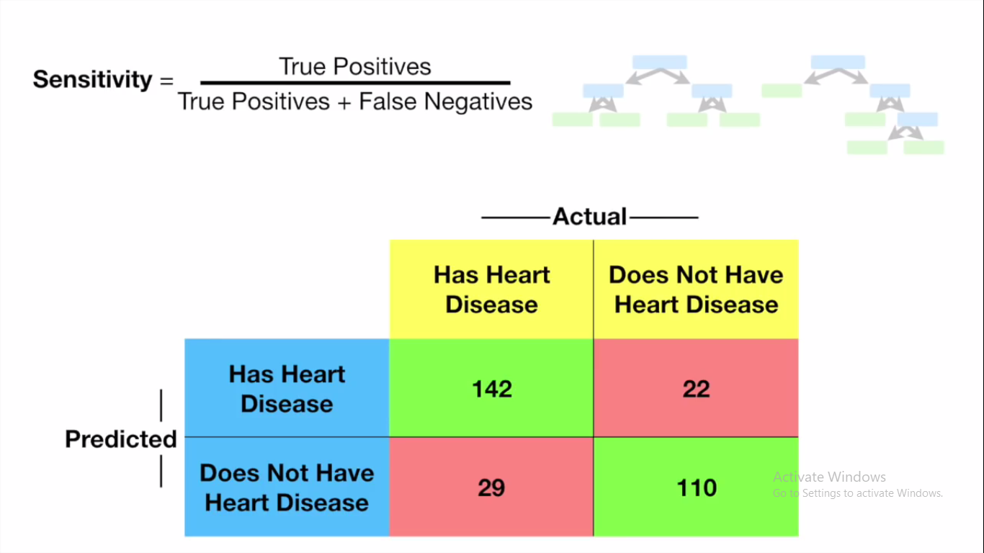

Slide 36
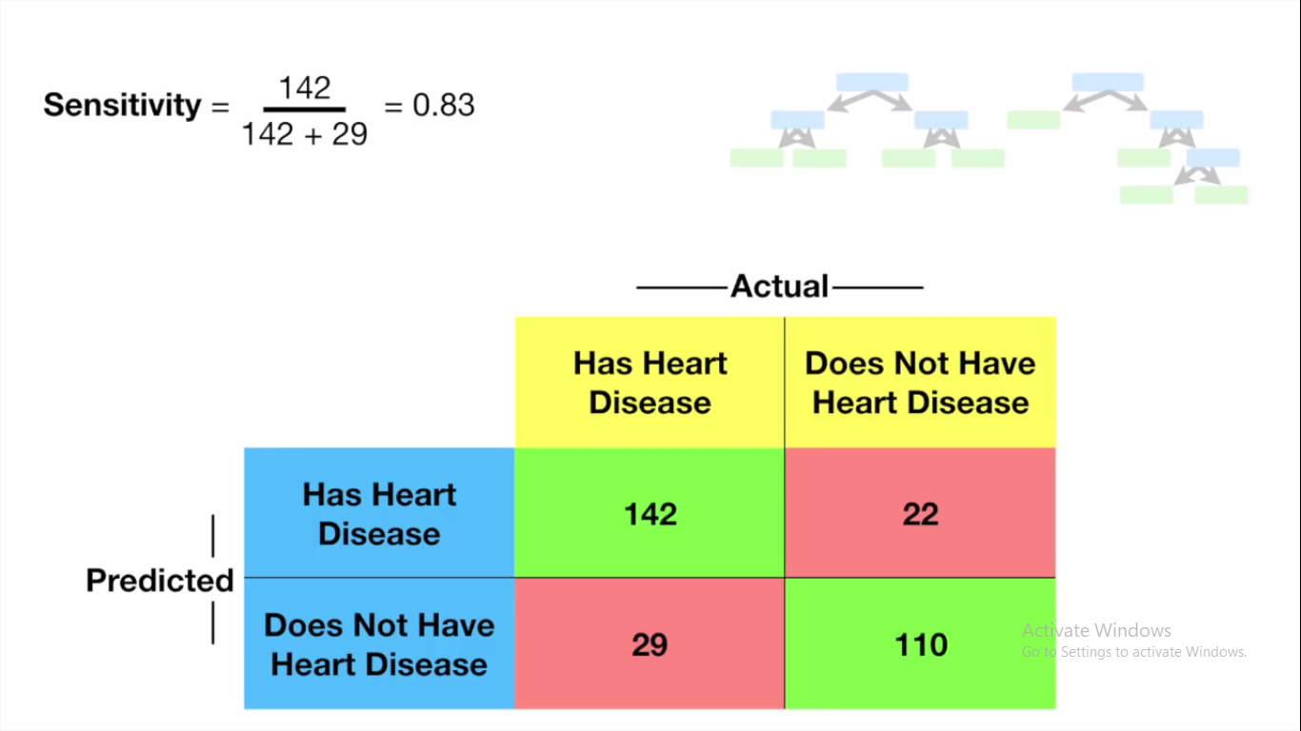

Slide 37
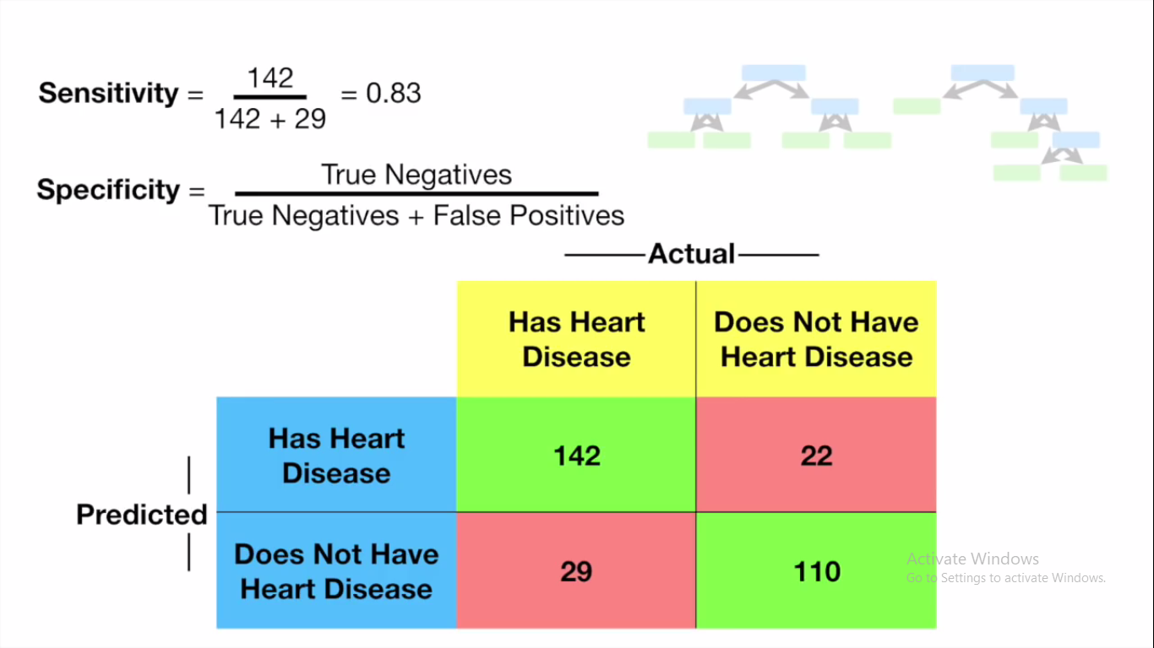

Slide 38
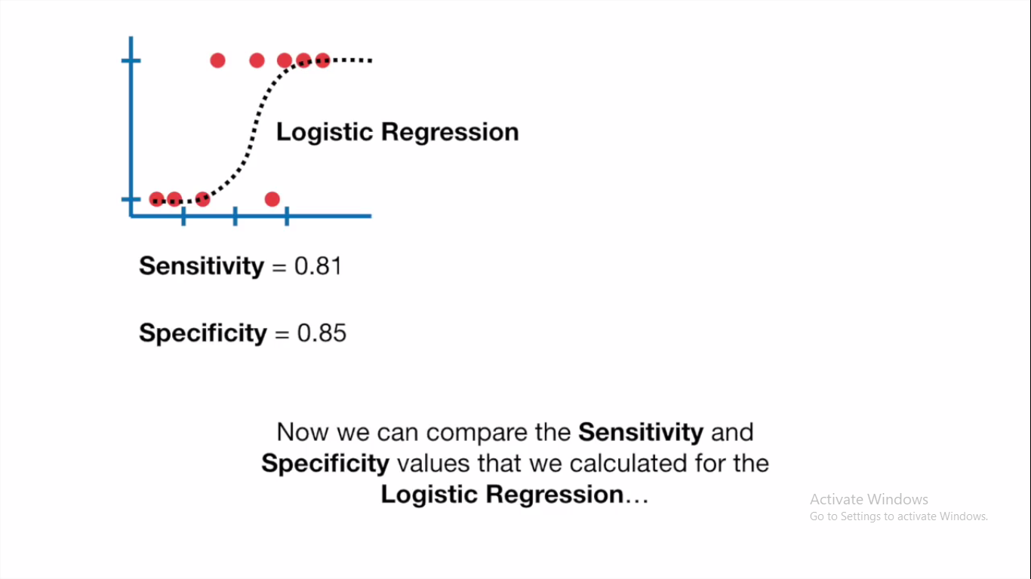

Slide 39
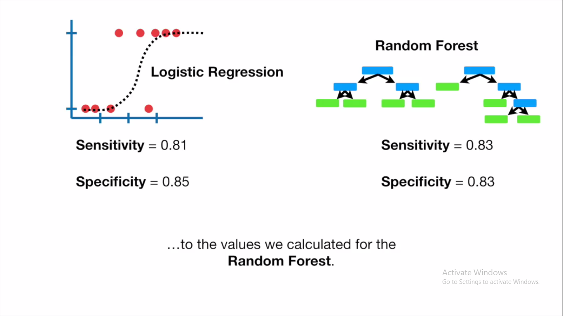

Slide 40
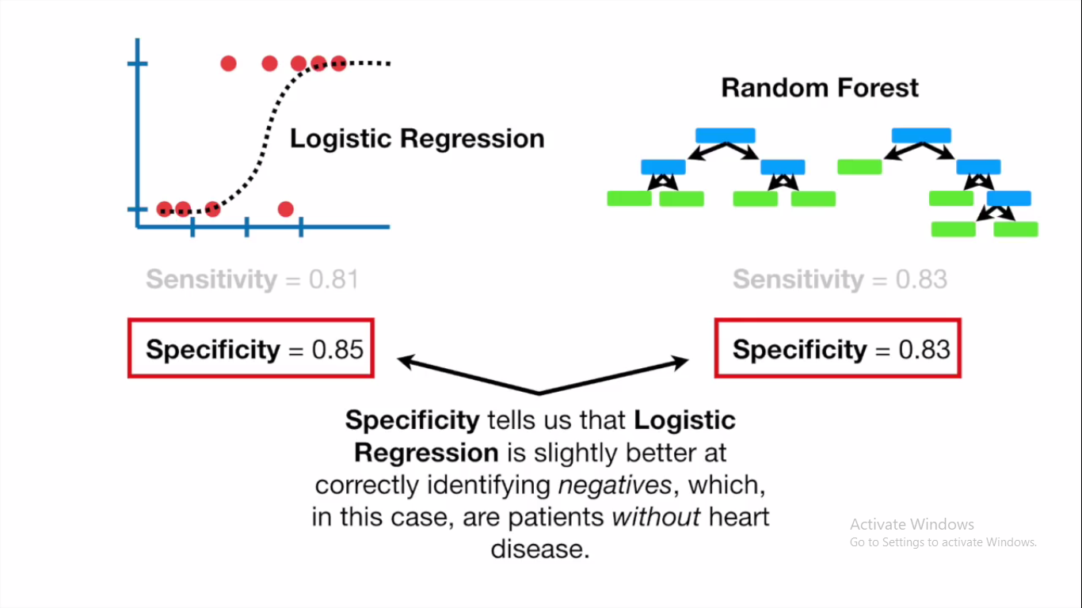

Slide 41
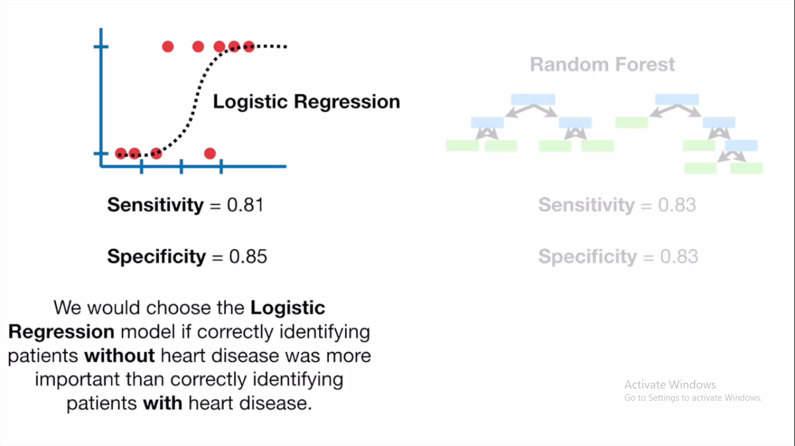

Slide 42
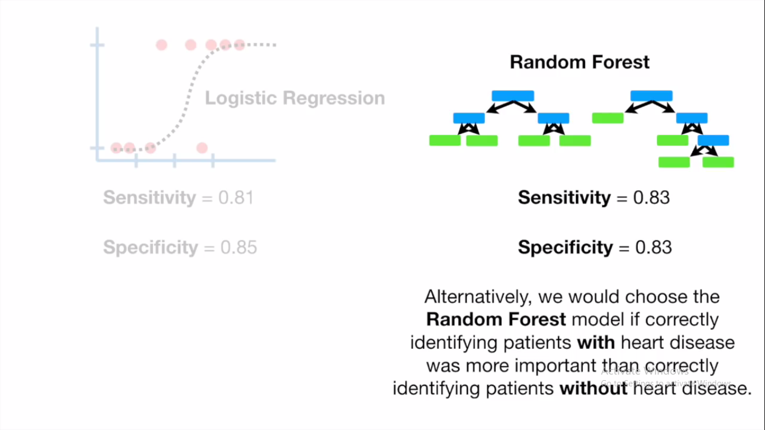

Slide 43
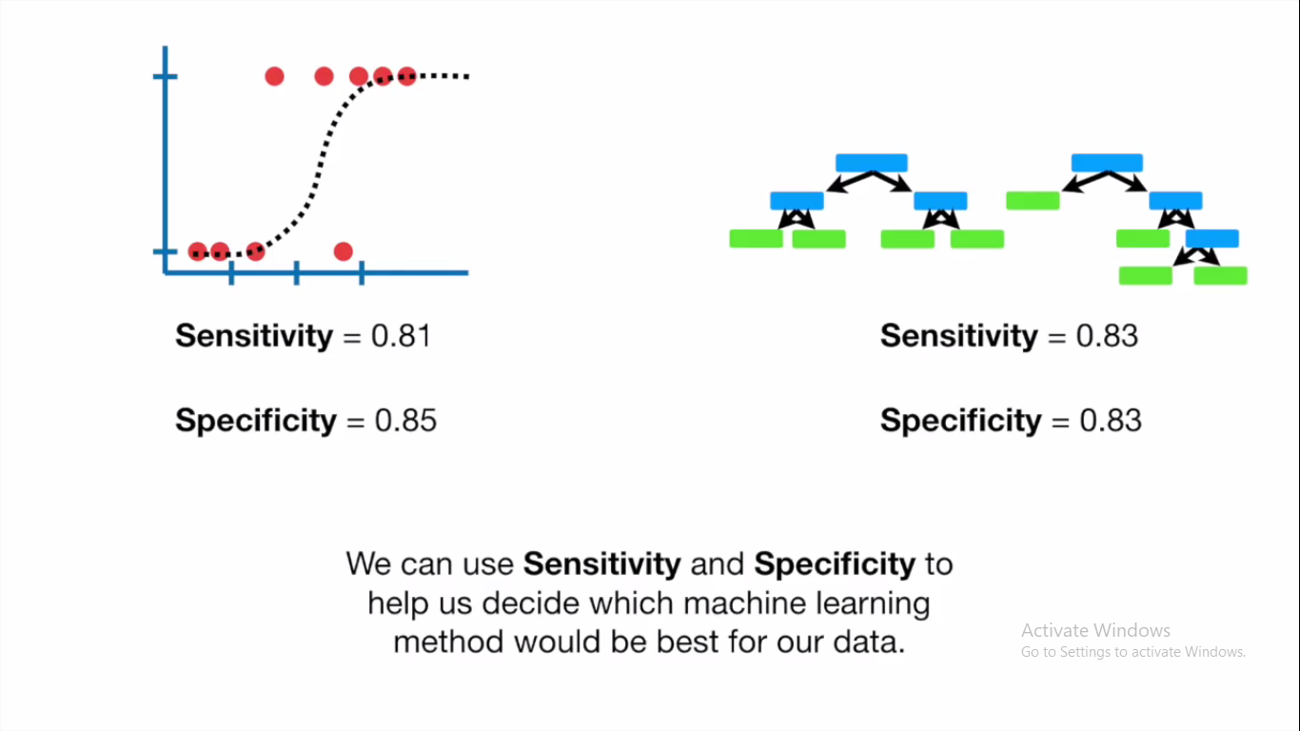

Slide 44
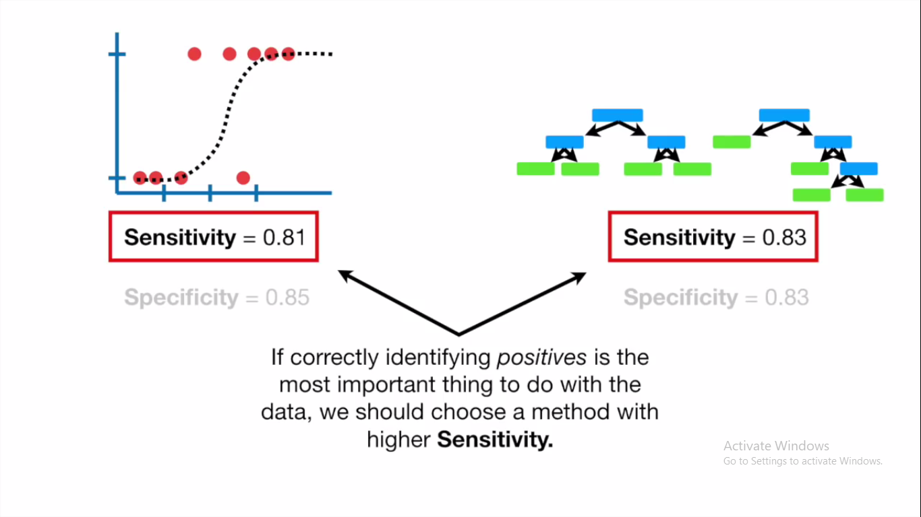

Slide 45
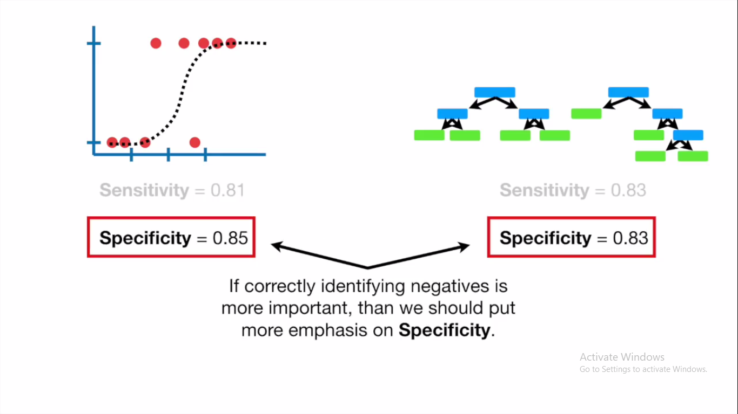

Slide 46
F1 Score / F-score / F-measure
Sometimes, we want to consider both Precision and Recall.
This can be achieved through an F1 Score.
It is defined as the harmonic mean of the model’s precision and recall.
F1 Score for Dog = 2* (Precision*Recall)/(Precision+Recall)
= 2* (0.42*0.75)/(0.42+0.75) =0.53

